Slide 1
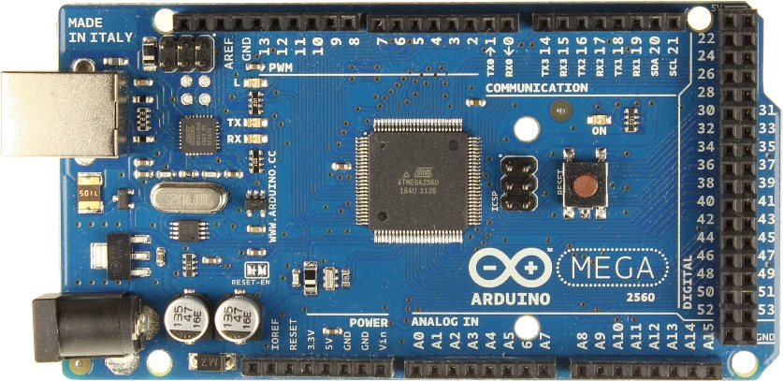
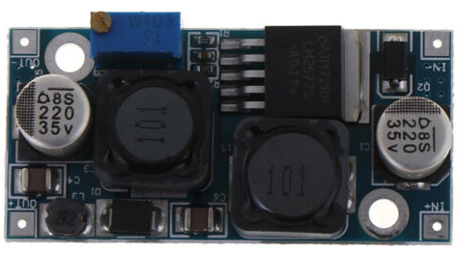
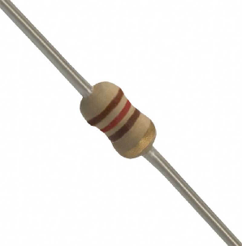
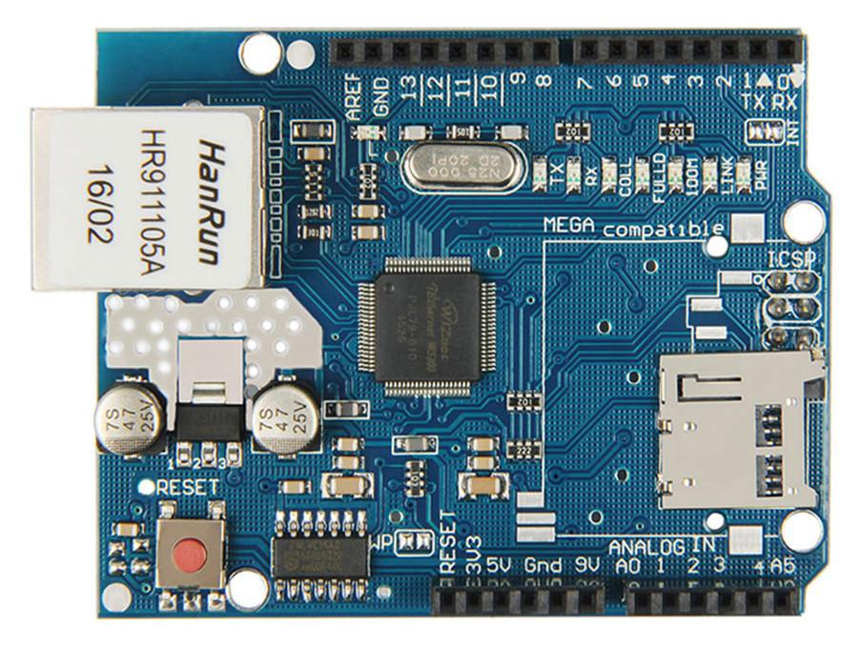
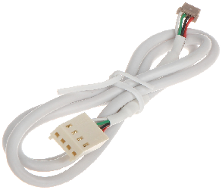
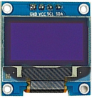
Paradox Ethernet/USB Interface Components
LM2598
DC-DC Down Converter
120 Ohm Resistor 0.25W
Arduino Mega 2560
Or Compatible e.g. Funduino
Ethernet Shield
W5100
Display SSD1306
128X64
Paradox Serial Cable

Slide 2
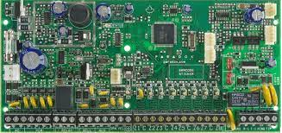
Paradox Ethernet/USB Interface Block Diagram
Paradox Ethernet/USB Interface
LM2598
Ethernet
Paradox SPxxxx - EVOxx
OLED
128X64
Ethernet
Shield
12V DC
UART
SPI,Vcc
7V DC
5V DC
I2C
UART
Rx1/Tx1
Vin
5V
SDA/SCL
Arduino MEGA 2560
USB

Slide 3
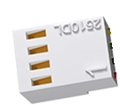
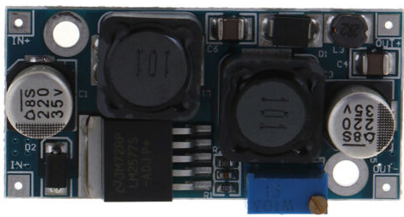

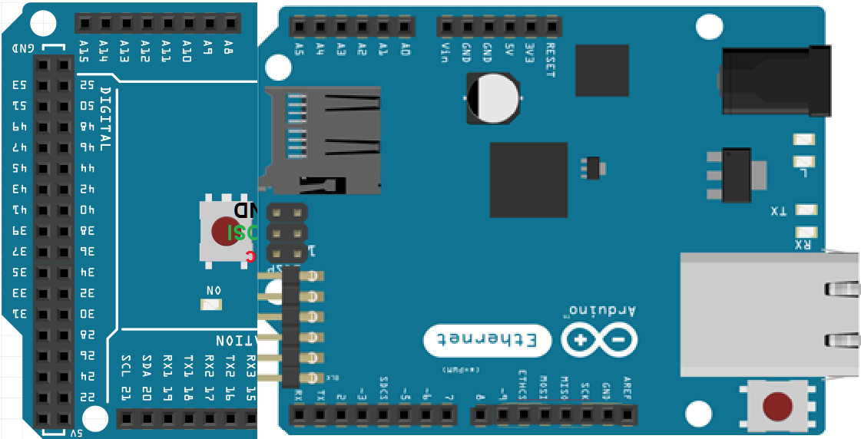
Paradox Ethernet/USB Interface Wiring
LM2598
7VDC
External DC-DC down converter in use to avoid overheating of Arduino Board Voltage Regulator
12V DC
Adjust for 7V DC Output
GND
120 Ohm
GND
Wire 120 Ohm Resistor after successful programming.
Only Required for proper USB Operation
Paradox
Panel
Rx
Tx
Arduino
MEGA 2560
GND
5VDC
SCL
Ethernet
Shield
Optional Display
SDA
LAN
USB
Rx1
SCL
Tx1
Display SSD1306
128X64
SDA

Slide 4
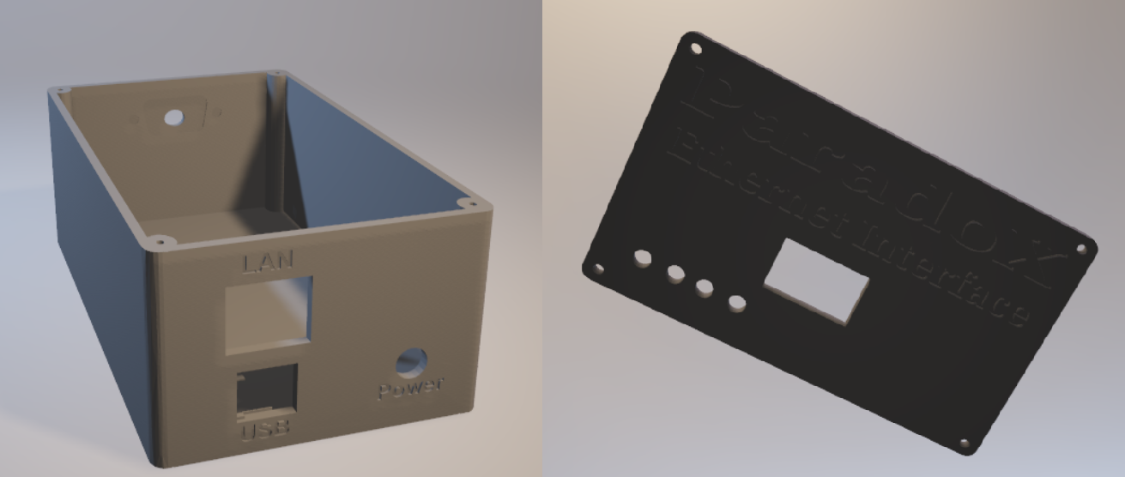
Paradox Ethernet/USB Interface
3D-Print Enclosure
Bottom Case
Top Case

Slide 5
Guidelines
USB Connection to Panel (usb to serial implemented on Paradox Interface) similar function to 307USB.Requires 120-Ohm Resistor between Reset and 5V.
DHCP functionality and OLED display to inform IP address and Serial Settings.
Static IP addressing is recommended.
Up to 3 multiple Connection.
Telnet to Port 23 to show device CLI.
Settings stored to internal EEPROM.
Serial Baud rate is configurable to support SP and EVO series Panels.
OLED Display is optional but recommended , for convenient use , as informs for device IP address and Serial Settings
DC-DC down converter is optional but recommended to avoid over heating Arduino Board regulator.
3D-Print case has been designed to accommodate device.Two versions have been designed with/without OLED 128X64 Display.

